Slide 1
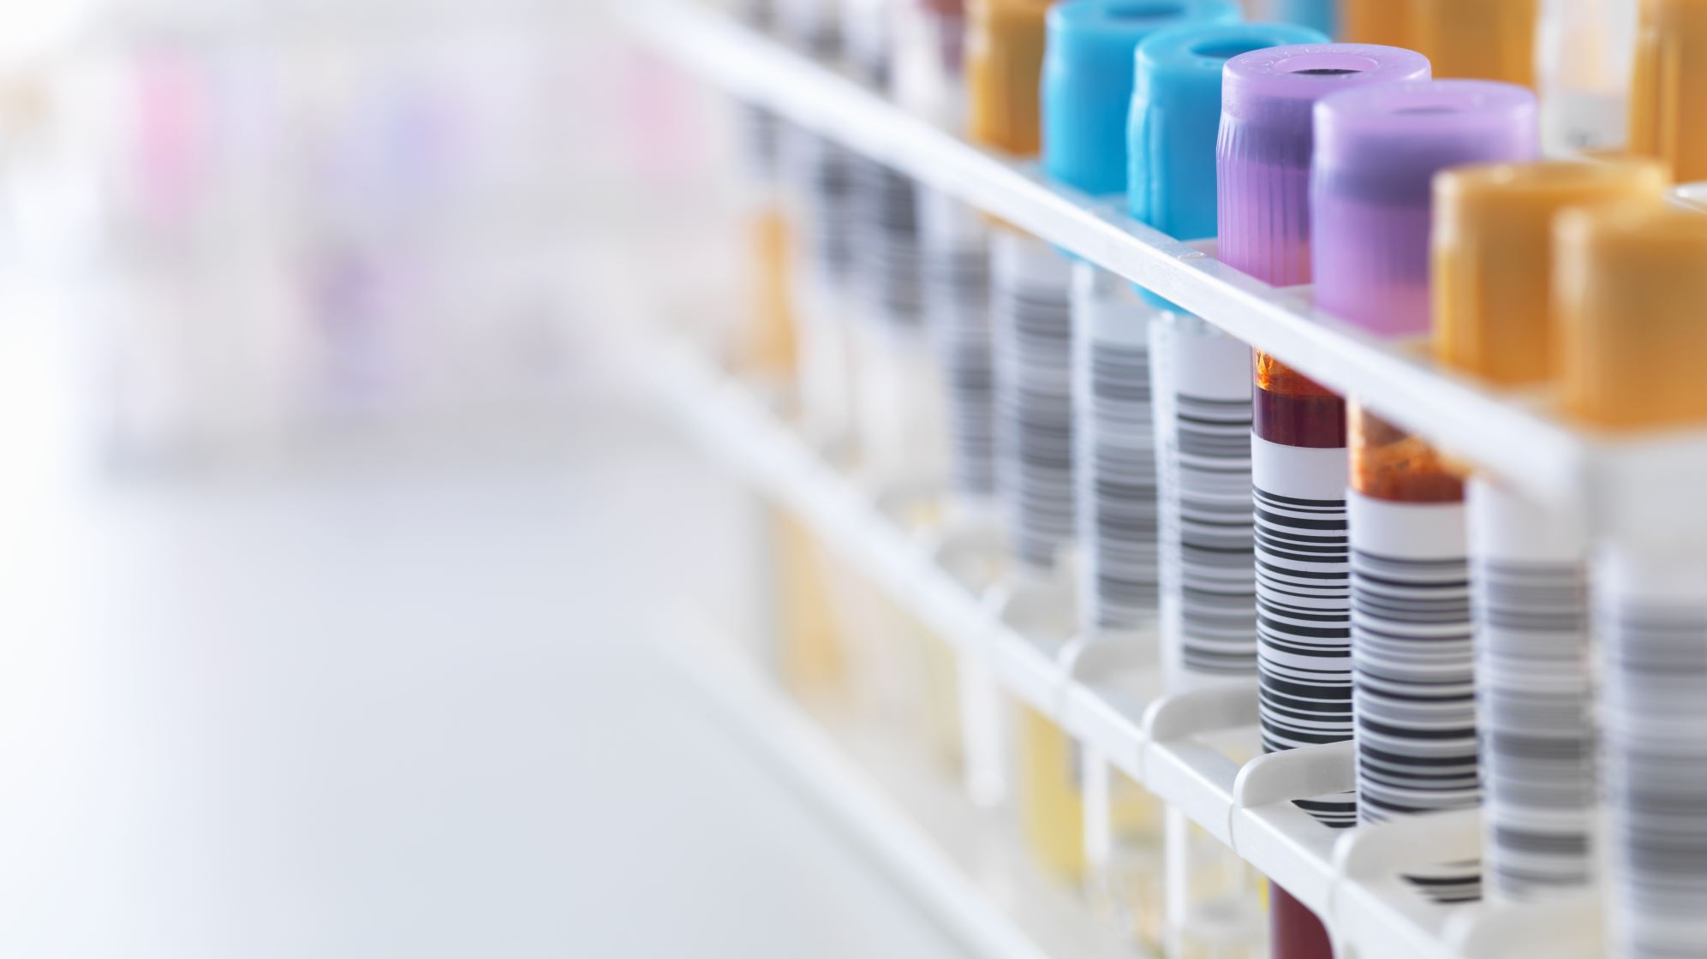
Four Applications of Biotechnology
BY – DESINGHAGE A.T.
MODULE – INTRODUCTION TO INFORMATION TECHNOLOGY (SC1172)

Slide 2
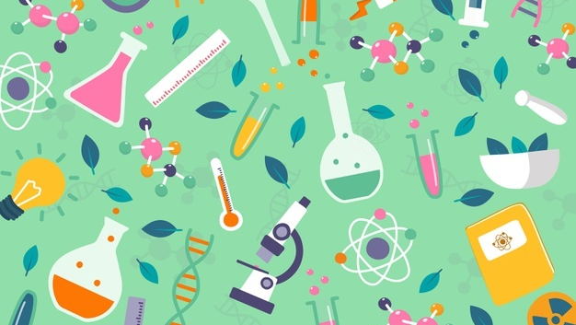
BIOTRCHNOLOGY ?
Notes:
A technology that uses biological systems or living organisms to create or modify products for a particular purpose.

Slide 3

Marine
Agriculture
Nutrition
Ethics & Low
Health & Medicine
Areas of Biotechnology
Bioinformatics
Industrial
Arid
Bioweapons
Environment

Slide 4
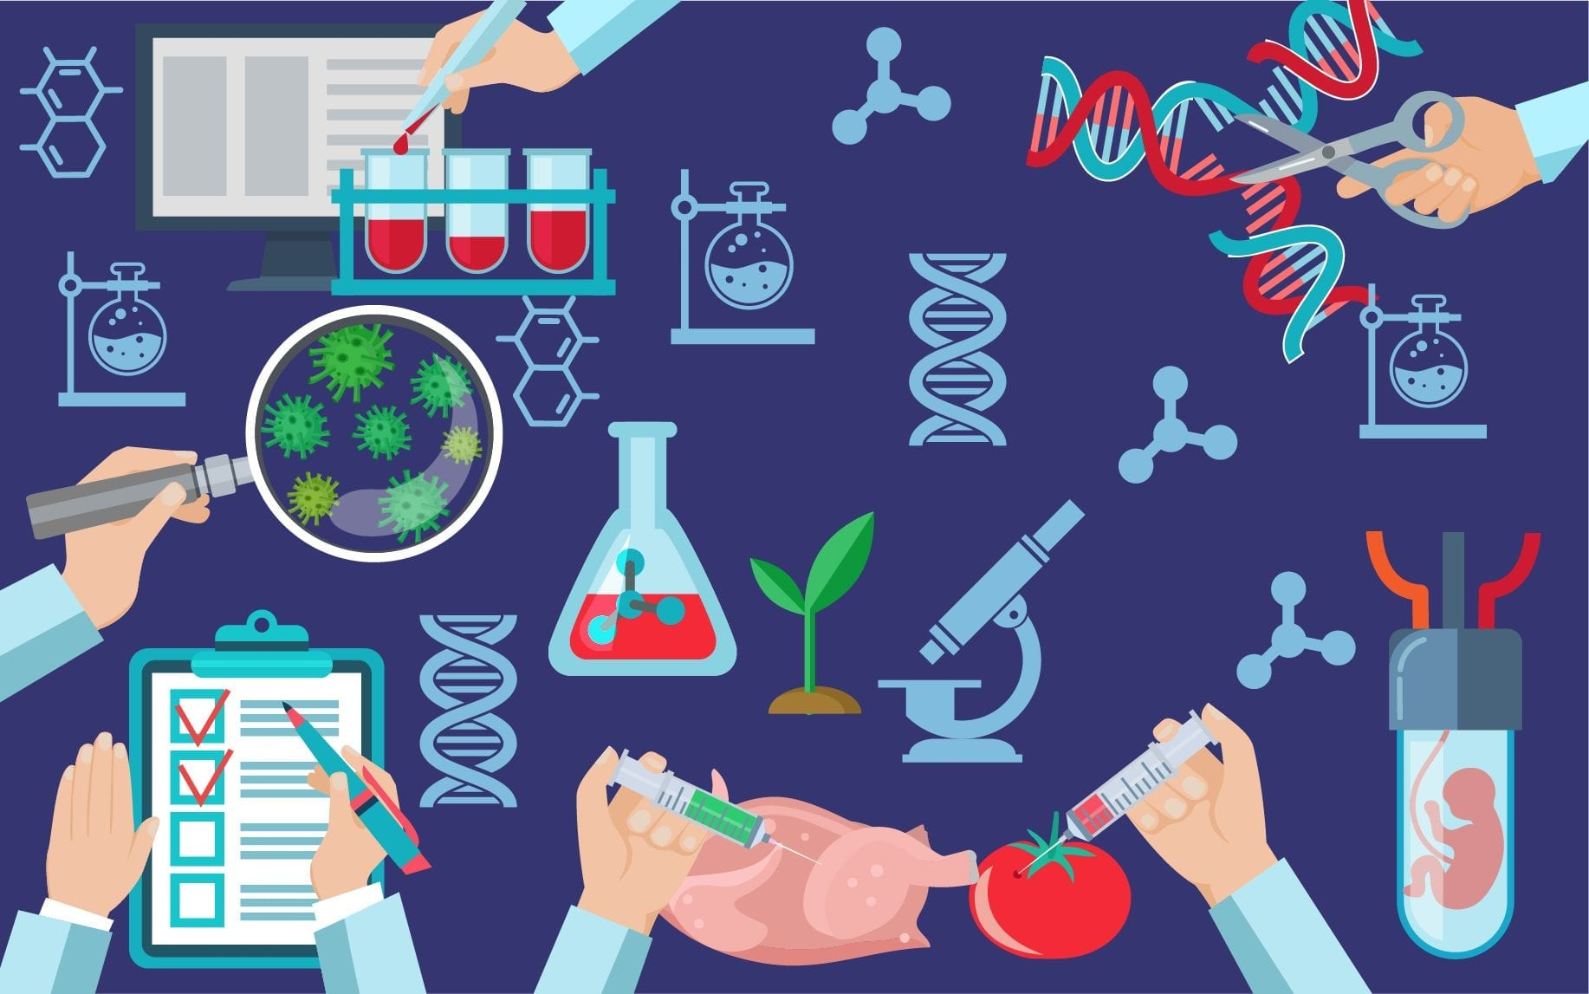
Let’s move on to few of Biotechnological application -:
Agricultural Biotechnology
Marine Biotechnology
Industrial Biotechnology

Slide 5
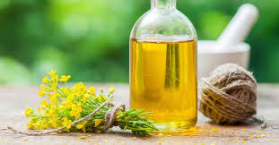
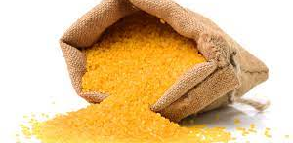
Agricultural Biotechnology
Canola oil
Golden rice

Slide 6
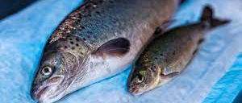
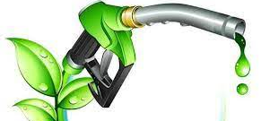
Transgenic fish
Marine Biotechnology
Biofuel
Cosmetics and Medicine

Slide 7
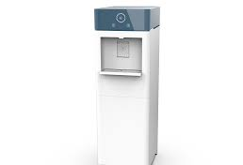
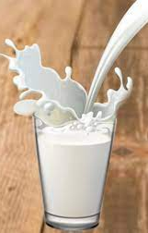
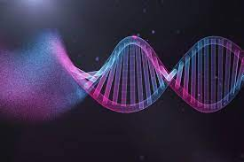
Water gen
Industrial biotechnology
Fat free milk

Slide 8

Reference
https://www.conserve-energy-future.com/biotechnology-types-examples-applications.php
https://www.google.com/search?q=background+biotechnology+wallpaper+hd&tbm=isch&hl=en&sa=X&ved=2ahUKEwivmojXnInzAhVbGLcAHfYvBRAQrNwCKAB6BQgBELkB&biw=1349&bih=635#imgrc=HgsgFGykqXL6yM
https://www.facebook.com/watch/?ref=search&v=361479721842515&external_log_id=82962f9f-af50-4432-8b70-895beae1cb19&q=nas%20daily%20water%20gen
https://www.youtube.com/watch?v=3ZQDD0Vm8SA
Thank you…!

